Slide 1
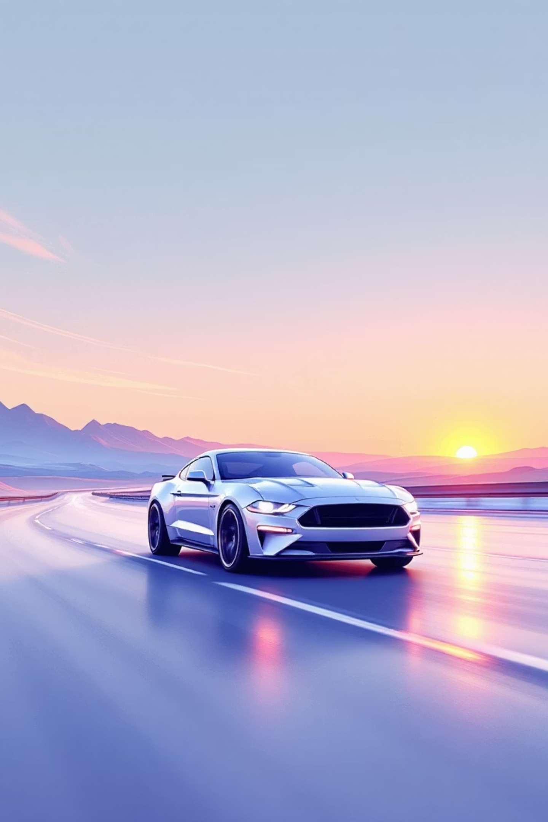

Ford Mustang
The Legend of American Muscle

Slide 2
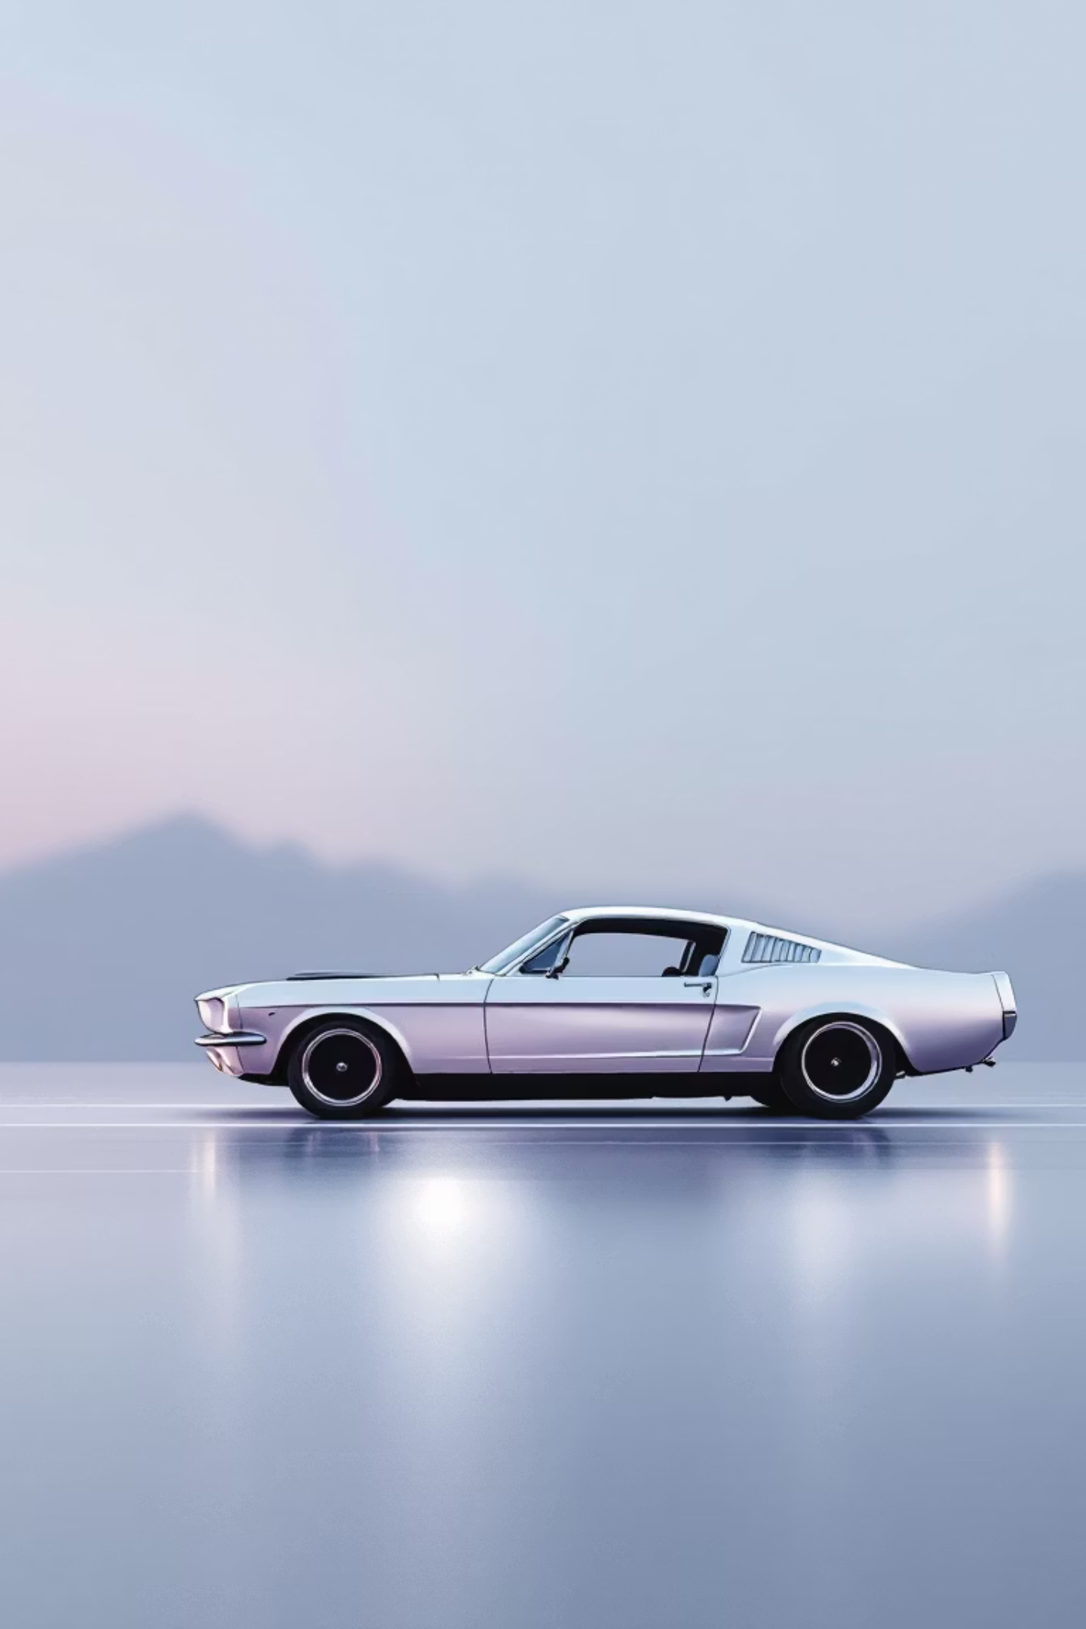
ABSTRACT
• The project is a responsive, interactive website showcasing the Ford Mustang.
• Built using HTML for structure, CSS for styling, and JavaScript for interactivity.
• Focuses on visual storytelling, dynamic UI, and modular code design.

Slide 3
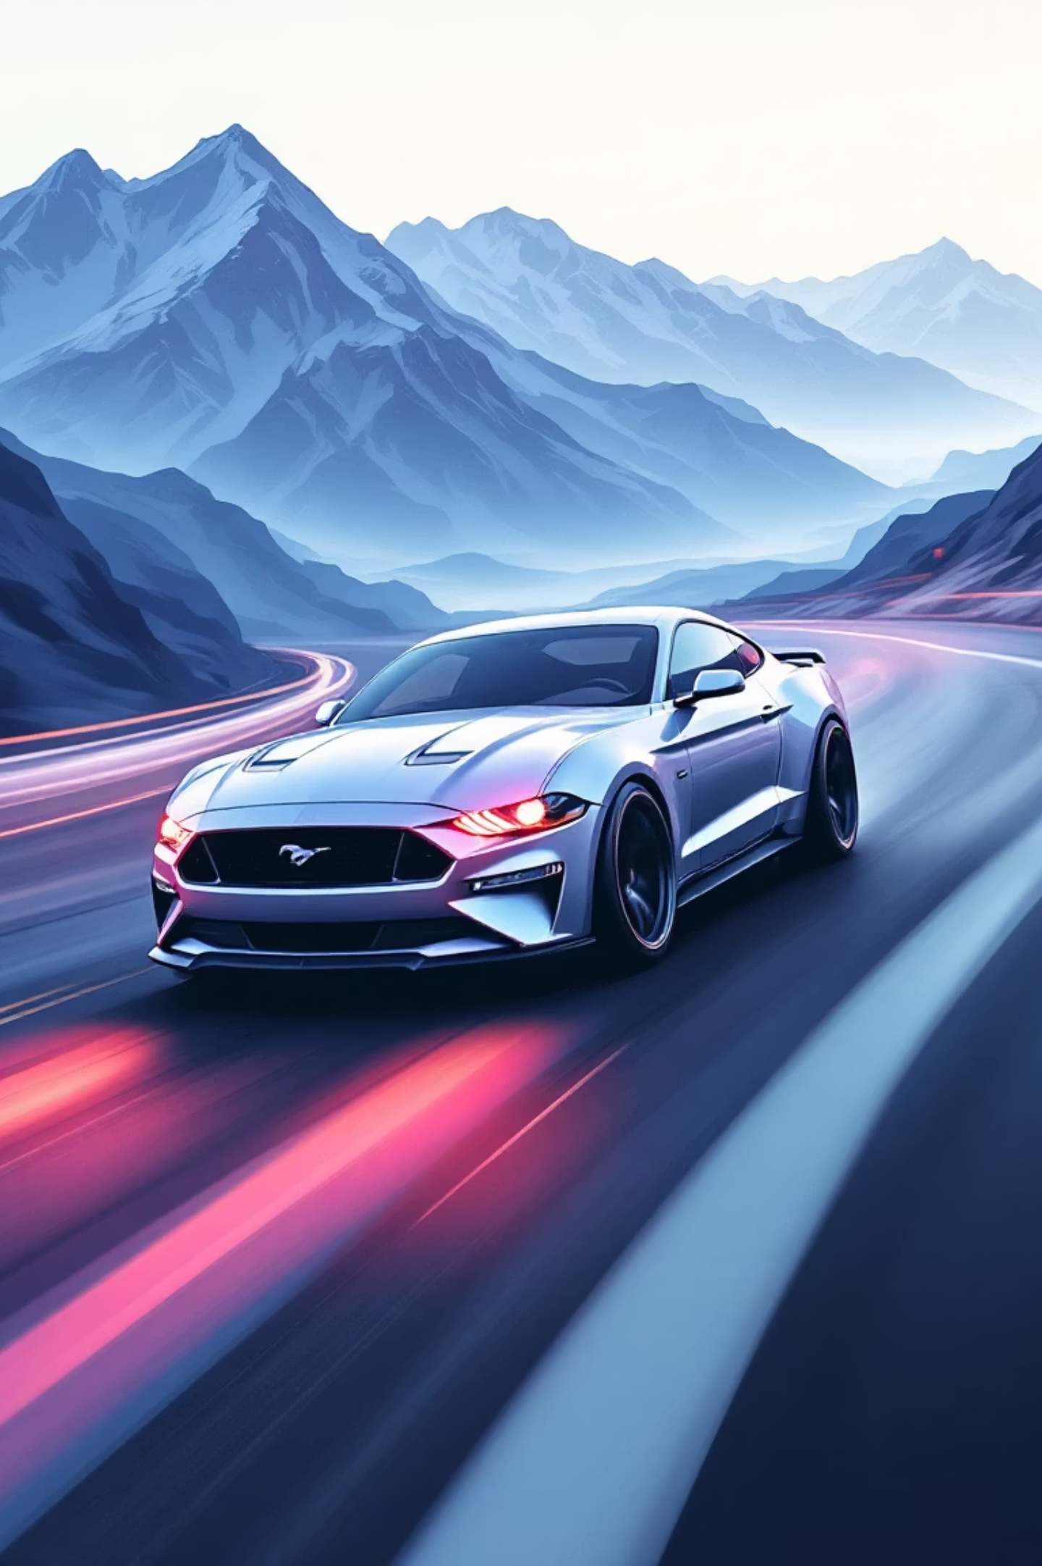

Existing System
Traditional car showcase websites are often:
Static and text-heavy.
Limited in interactivity.
Not optimized for modern UI/UX trends.
Lack of immersive visuals and
Modular navigation.

Slide 4
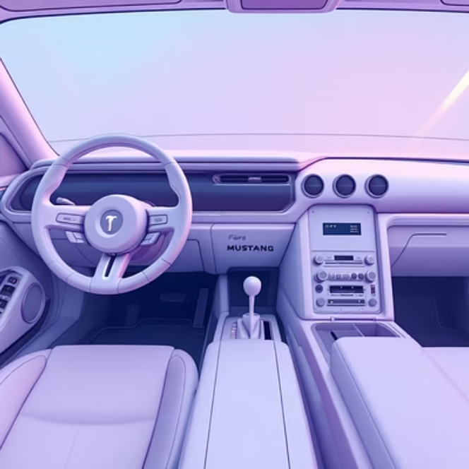
Proposed System
A modern, cinematic Mustang showcase website with:
Video backgrounds and high-quality images.
Interactive navigation (buttons, hover effects, smooth scrolling).
Dynamic content loading using JavaScript.
Responsive design for desktop and mobile.

Slide 5
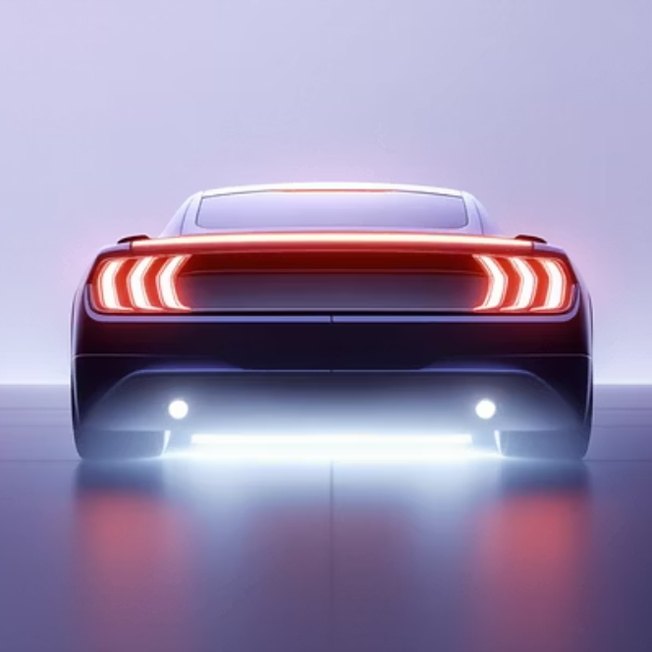
Advantages
Engaging and visually dramatic presentation.
Cross-platform compatibility
Easy to extend with new modules
Portfolio-ready: highlights technical and creative skills.

Slide 6
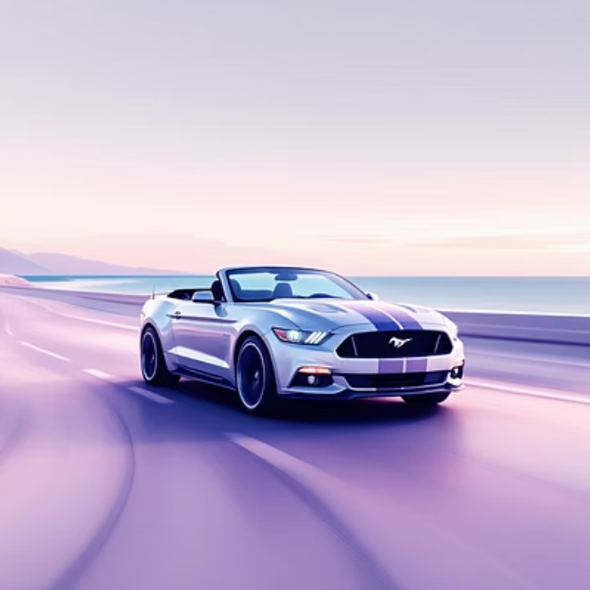
Disadvantages
• Requires high-quality media assets (large file sizes).
• Performance may vary on low-end devices.
Limited to front-end only (no database integration).

Slide 7
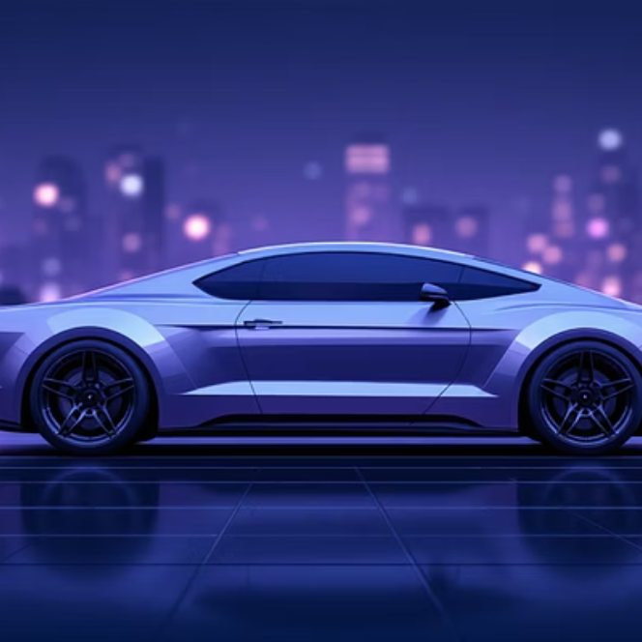
Hardware Requirements
Minimum Requirement
Dual-core processor, 2 GB RAM.
Any modern browser (Chrome, Edge, Firefox).
Recommended:
Quad-core processor, 4 GB+ RAM.
Full HD display for best visuals.

Slide 8
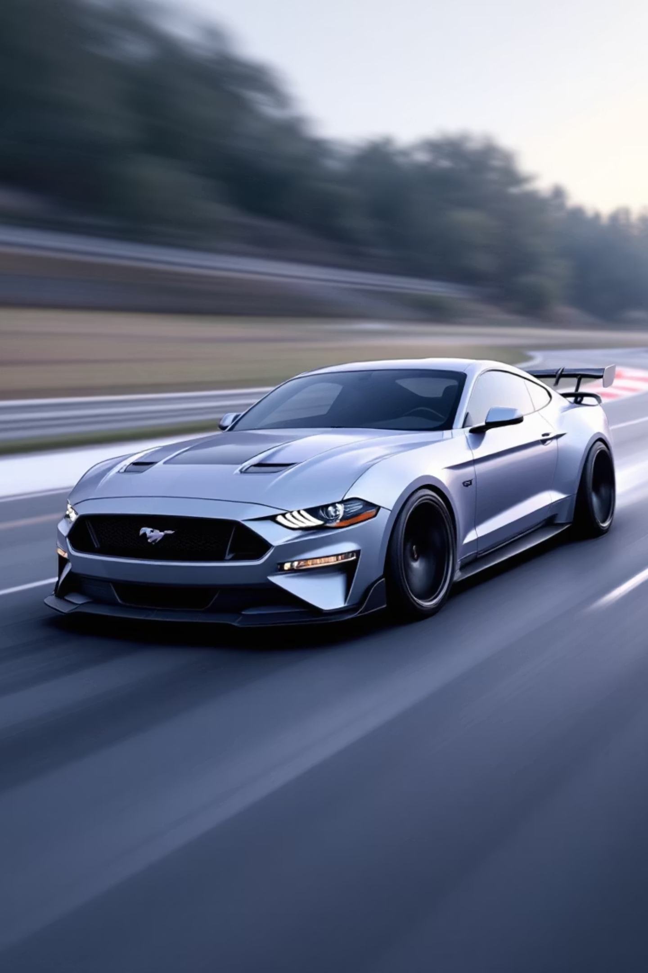
Software Requirements
Development Tools:
VS Code / Sublime Text.
Browser Developer Tools.
Languages: HTML5, CSS3, JavaScript
Optional: Git for version control.

Slide 9
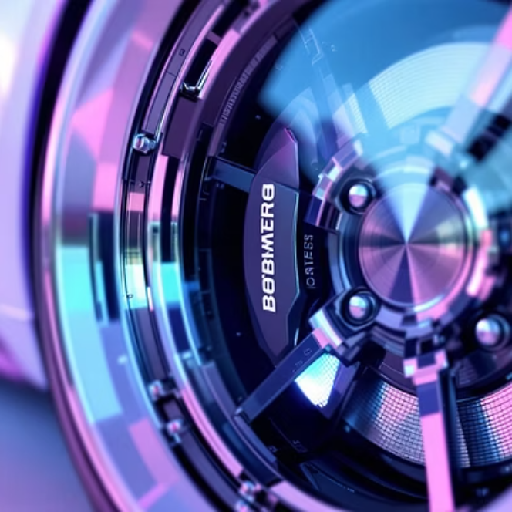
Modules
Home Page – Landing with video background.
About Mustang – History and legacy.
Models Showcase – Interactive car gallery.
Specifications – Tabular/animated details.
Contact/Booking – Simple form with validation.

Slide 10
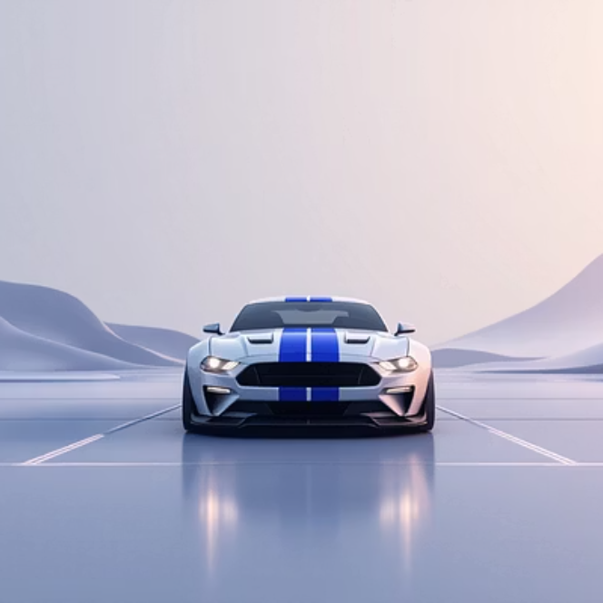
Module Description
Home Page: Cinematic intro with background video and call-to-action buttons.
About Mustang: Timeline of Mustang evolution with images.
Models Showcase: JavaScript-driven carousel/gallery.
Specifications: Expandable sections with performance stats.
Contact/Booking: Form validation using JavaScript.

Slide 11
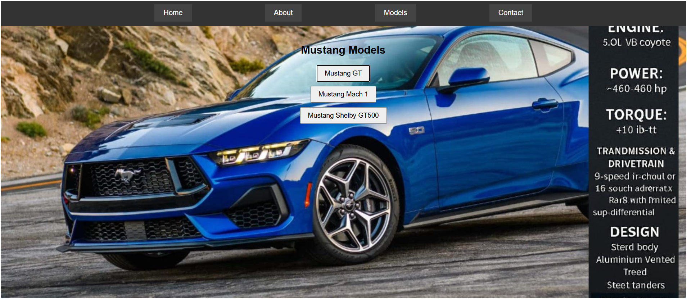
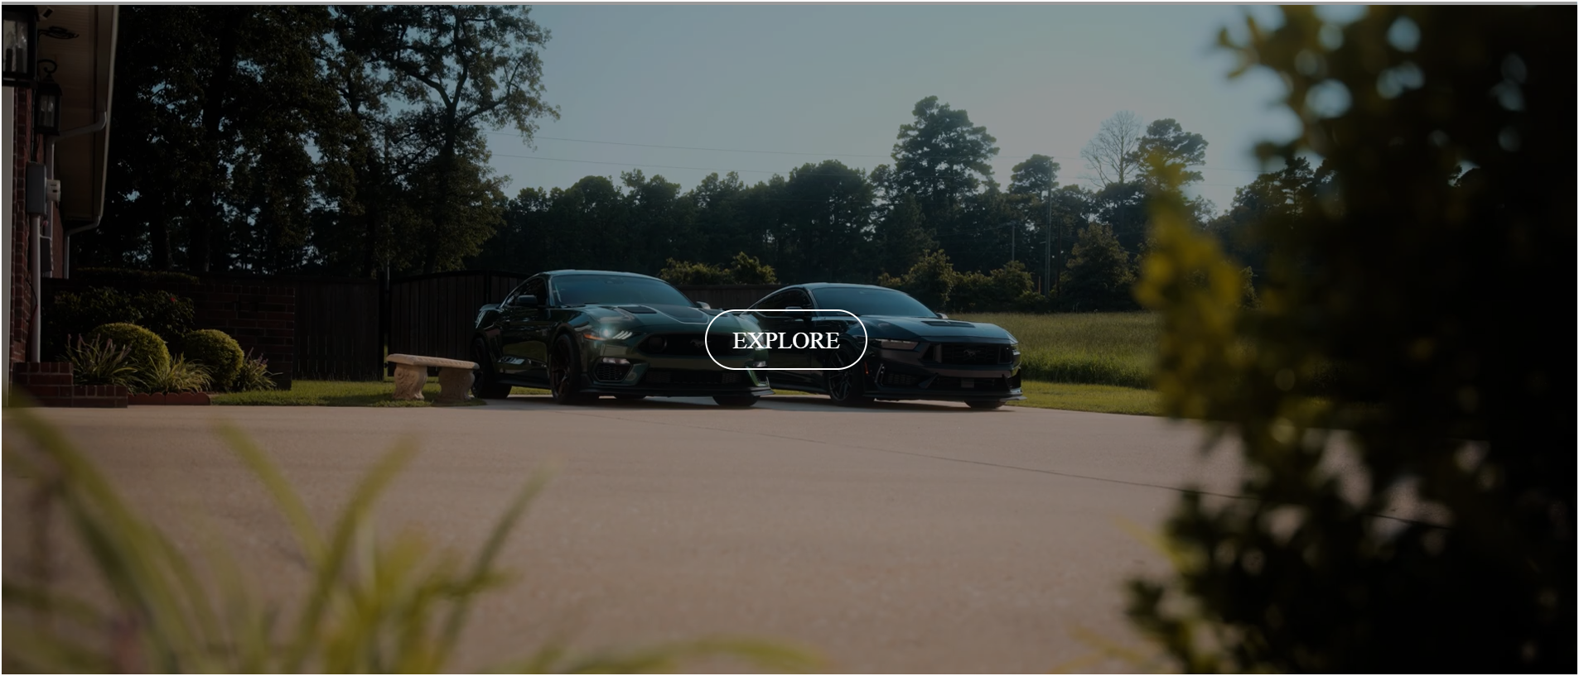
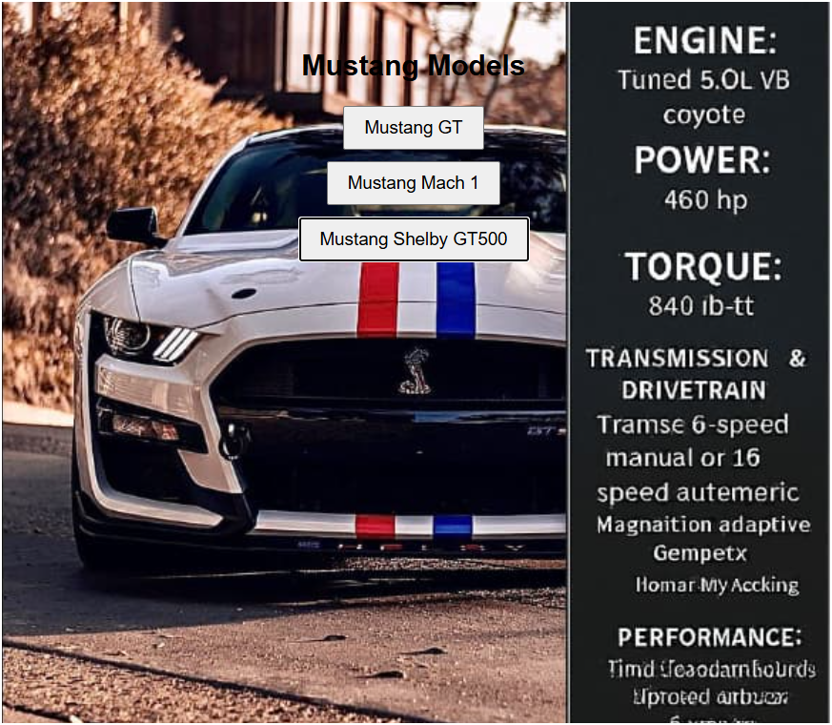
Sample Output (Screenshots)

Slide 12
Conclusion
Successfully built a responsive, interactive Mustang website.
Demonstrated front-end development skills in HTML, CSS, and JS.
Created a cinematic, portfolio-ready project that blends technical rigor with visual storytelling.
Future scope: Add backend integration, user login, and 3D car models.

